Slide 1
Parking Tracker
Vitaliy Gavrilov, Jason Moss, Joel Uyesugi, Ryan “Bob” Dean

Slide 2
Project Overview
Parking Tracker is designed to be a tool for use in gathering data on parking habits and statistics in the South Waterfront in Portland.
This will be done by utilizing an Android app to collect data to identify parked vehicles in specific parking spots in the South Waterfront area using license plate numbers, and send this data to the online database for later analysis.

Slide 3
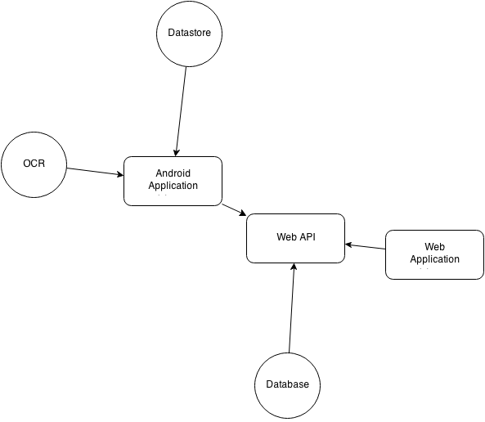
Project Architecture
Android App will use OCR engine to pull license numbers from plate
This data will be sent to the Web API, along with the time and location
Data will be inserted into the database, where it can be accessed later for analysis on the back end

Slide 4
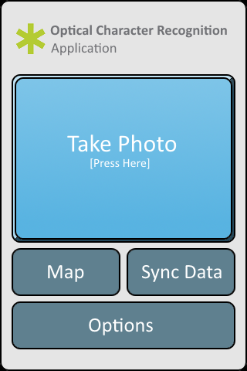
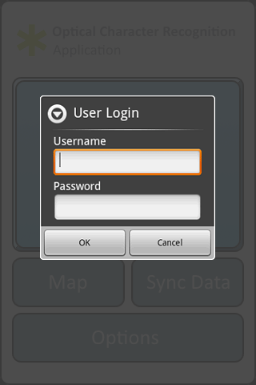
Front End - UI
“Take Photo” will pull up the built in camera of the device.
Map will pull up the Google Map of your current location, or a wireframe map of parking spots.
Sync Data will upload collected data to the server.
Logins will be provided by the SWCR.

Slide 5
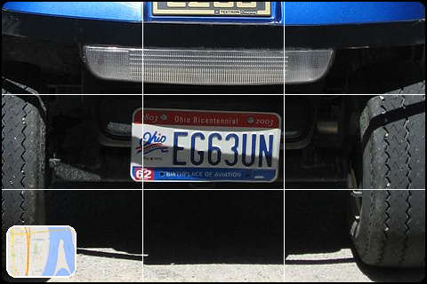
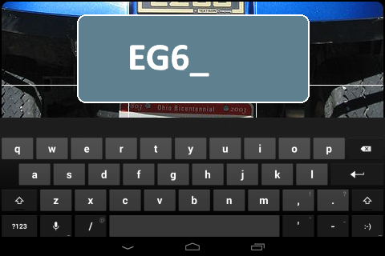
Front End - UI
In a perfect world, the data will be interpreted by the app correctly every time. However, neither pictures nor the engine itself are perfect. In these cases, manual entry will be available.
Manual entry is slow however, thus undesirable. We hope to avoid this situation whenever possible.
An option to retake the picture will also be available.

Slide 6
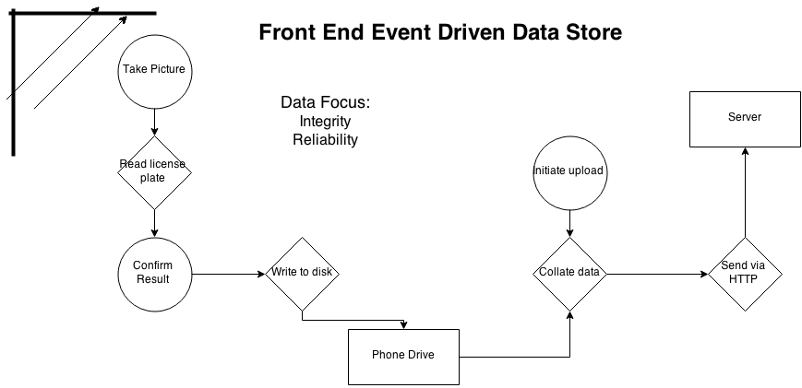
Front End - Data

Slide 7
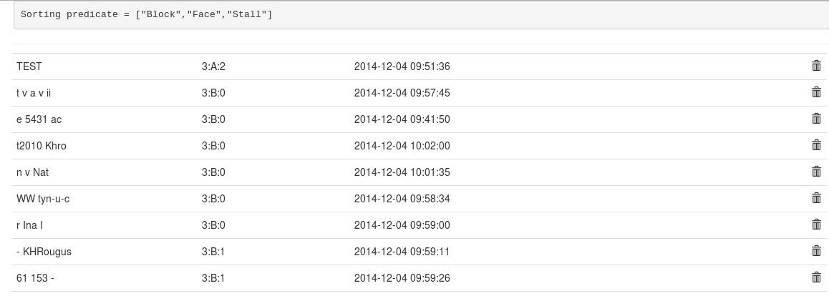
Web App
The web app provides a REST API that the Android application utilizes. It collects and stores license plate data, location, and time to be used in analysis. The above data was collected from tests with the OCR engine on assorted bits of text.

Slide 8
Technology
Mobile
Android
OpenALPR
Web API
PHP - Slim Framework
Web App
AngularJS
Bootstrap
Development
Github
Eclipse
Atom

Slide 9
Work Distribution
Vitaliy - OCR, Android data
Joel - Android UI
Bob - API integration
Jason - Web API/Web App

Slide 10
Demo
http://parking.bitsrc.net/app/

Slide 11
Work Left to Do
Block Mapping
Map Integration
More accurate results with OCR Engine
UI
User Authentication
Further Analysis

